Slide 1
Corona travel
Resources and microservices

Slide 2
Product description
Our goal is to allow users to travel online from home via any device of their liking. They'll start by opening an app or a link and choosing a desired destination. After choosing a location, users can choose to view destination in 3D, look at some 3D photos or videos or learn some facts about the place.
Team: Sofya Donskaya, system analyst; Elena Karelina, backend developer; Danil Kireev, frontend developer; Artem Filimonov, backend developer + API integrator
Repo: https://github.com/randomunrandom/corona_travel
Report: https://docs.google.com/presentation/d/14muV41FoflKnEn1uf8nVNDLdu6MtURisamITFwXzZ7k/edit?usp=sharing

Slide 3
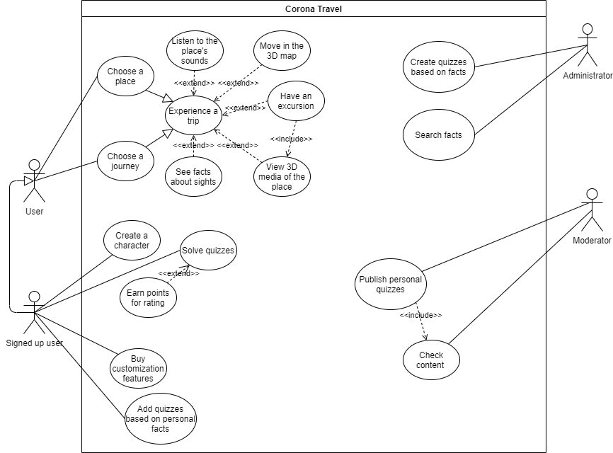
Use case diagram
Scenarios: https://github.com/randomunrandom/corona_travel/wiki/Scenarios

Slide 4
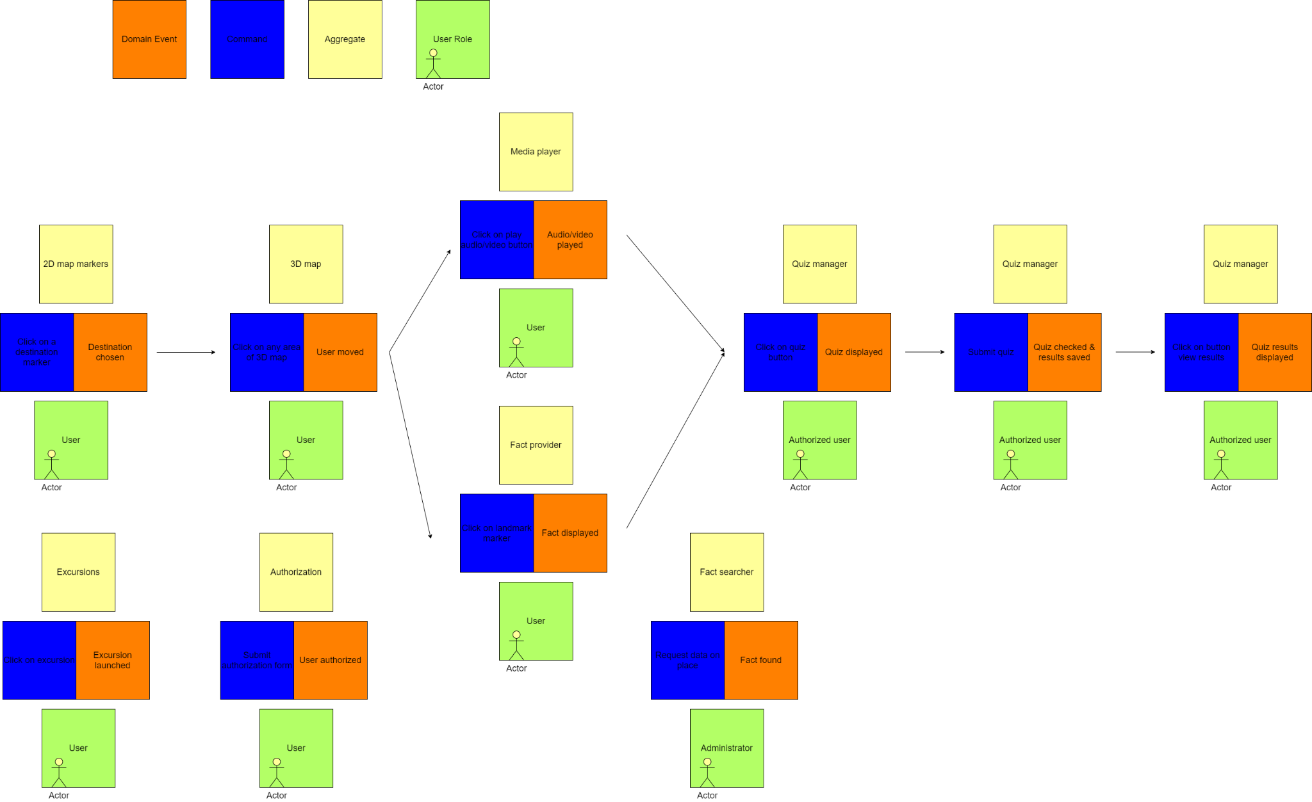
Event storming

Slide 5
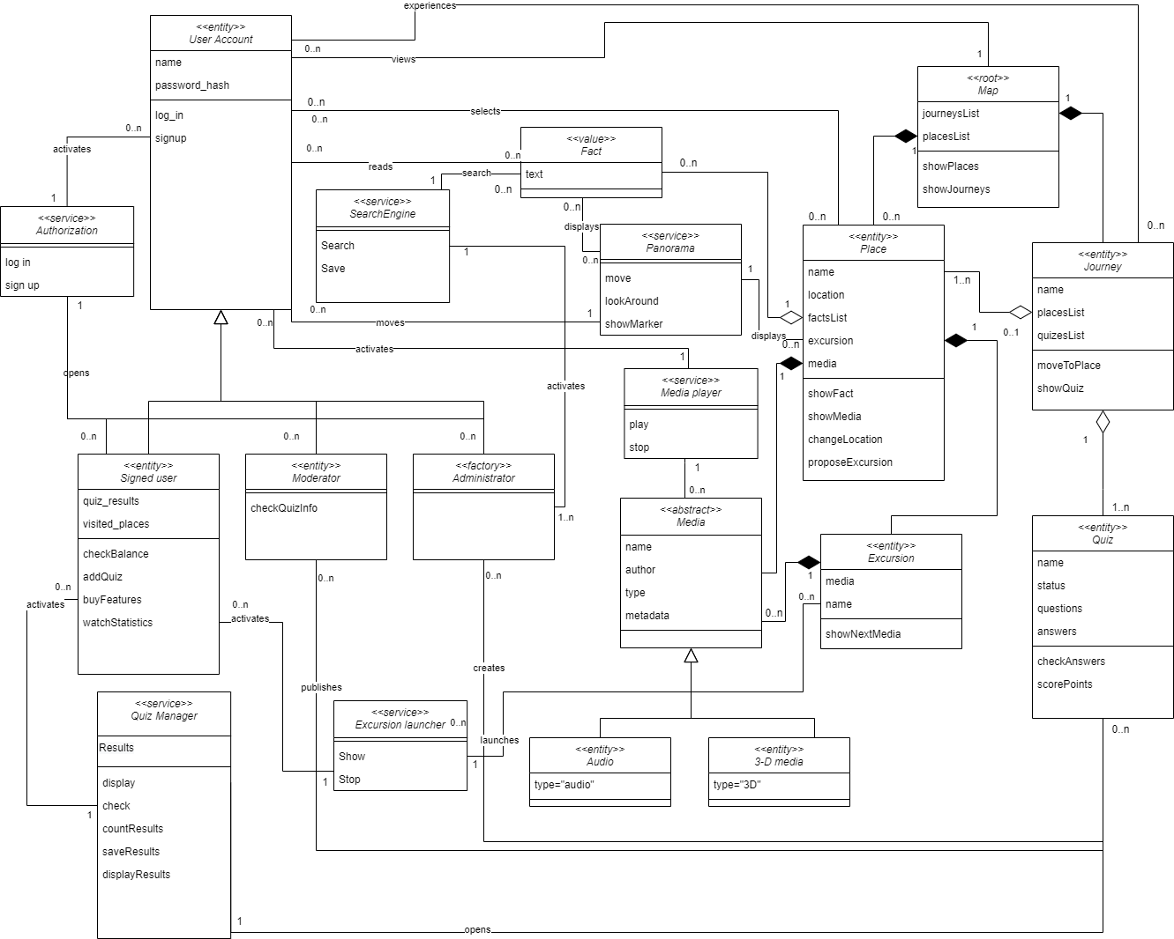
Detailed
class diagram

Slide 6
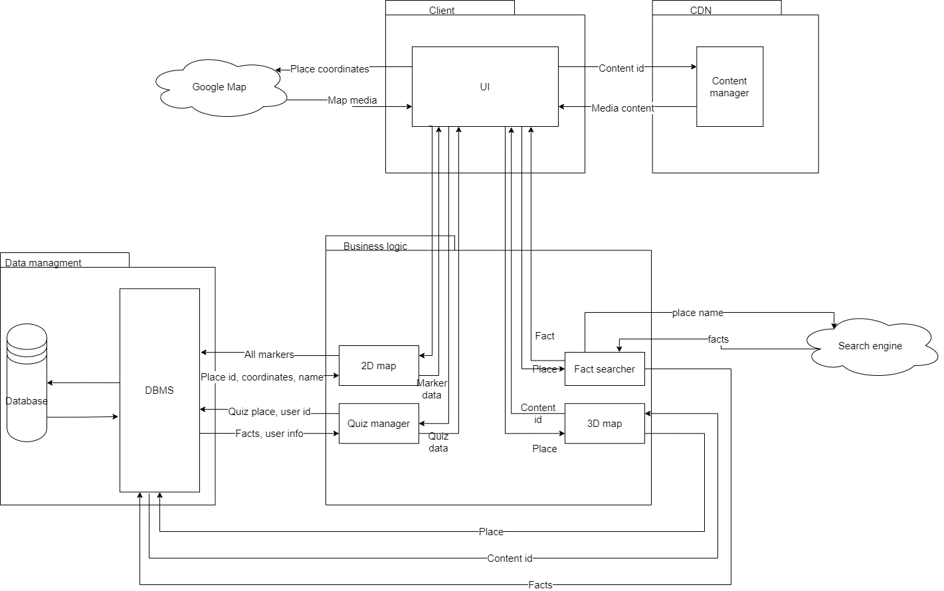
Service diagram

Slide 7
Traceability
Microservice (component) | Resource (interface) | Domain classes | Use case
2D map | Place | Map, 2D Marker | Choose a place
3D map | 3D Marker (Fact, Media, Excursion, Quiz) | 3D Marker, Panorama, Media, Excursion, Fact, Quiz | Move in the 3D map
Quiz manager | Quiz, Signed User | Quiz, Quiz manager, Signed User | Solve quiz
Fact searcher | Search engine, Fact | Search engine, Fact, Administrator | Search facts

Slide 8
Expected technology
ASGI
NoSQL (Document oriented DB)
Oauth 2.0
Containerization
CI/CD
Orchestration

